Slide 1
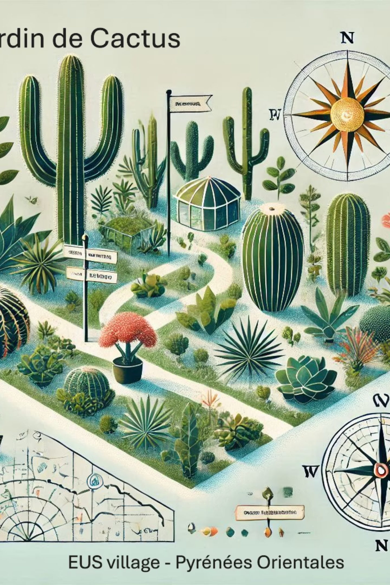
The Cactus and Artistic Garden of Eus: A Magical Experience
Welcome to a presentation about a truly unique horticultural project in the Pyrénées-Orientales region of France. The Exotic and Artistic Garden of Eus represents a novel concept in shared garden spaces, combining botanical expertise with artistic expression. This presentation will explore the vision, development, and future of this remarkable cactus garden that aims to create a peaceful sanctuary where visitors can reconnect with nature while experiencing rare and exotic plant species. Join us on a journey through this innovative project that has captured the imagination of the Occitanie region and beyond.

Slide 2

Vision and Concept: A New Kind of Shared Garden
For over four years, the team behind the Exotic Garden of Eus has been developing a revolutionary concept in shared garden spaces. Unlike traditional botanical gardens, this project combines several unique elements:
A specialised collection of cacti and succulents (Aloes, Agaves)
An open, accessible space for all visitors
A tranquil environment for nature observation
A productive garden growing rare fruits
A place for relaxation, reading, and connecting with nature
The garden is designed to be more than just a display of exotic plants; it aims to create a multisensory experience where visitors can take time to observe nature's wonders in a peaceful setting. The project embodies a philosophy of sharing—sharing knowledge, experiences, and the natural beauty of this unique landscape.
The garden will feature an extensive collection of cacti and succulents, carefully selected to thrive in the Mediterranean climate of the Pyrénées-Orientales. These drought-resistant plants not only create a striking visual display but also demonstrate sustainable gardening practices suitable for increasingly arid conditions in southern Europe.

Slide 3

Award-Winning Project: Recognition from Occitanie Region
Regional Recognition
Plan Montagnes d'Occitanie
Project Requirements
The Exotic Garden of Eus was selected as one of the winners of the participatory projects "Montagnes d'Occitanie," receiving financial support from the Occitanie-Pyrénées-Méditerranée Region. This recognition validates the project's innovative approach and its potential contribution to the local community and tourism sector.
The "Plan Montagnes d'Occitanie, terres de vie 2018-2025," developed by the State and the Region, places significant emphasis on innovation for the development of mountain areas in Occitanie. The plan specifically aims to fund projects that offer innovative solutions conceived and tested by mountain stakeholders, addressing unmet collective needs in the mountain territory concerned.
To qualify for this funding, projects must be concrete and quickly achievable, demonstrating practical applications that can benefit the local community. The Exotic Garden of Eus met these criteria through its unique combination of botanical conservation, sustainable agriculture, and community engagement.
The financial support from the Occitanie Region has been instrumental in bringing this ambitious project to life, allowing for the development of the garden's infrastructure and the acquisition of rare plant specimens. This partnership between local initiative and regional government demonstrates how innovative projects can be fostered through collaborative funding approaches.

Slide 4
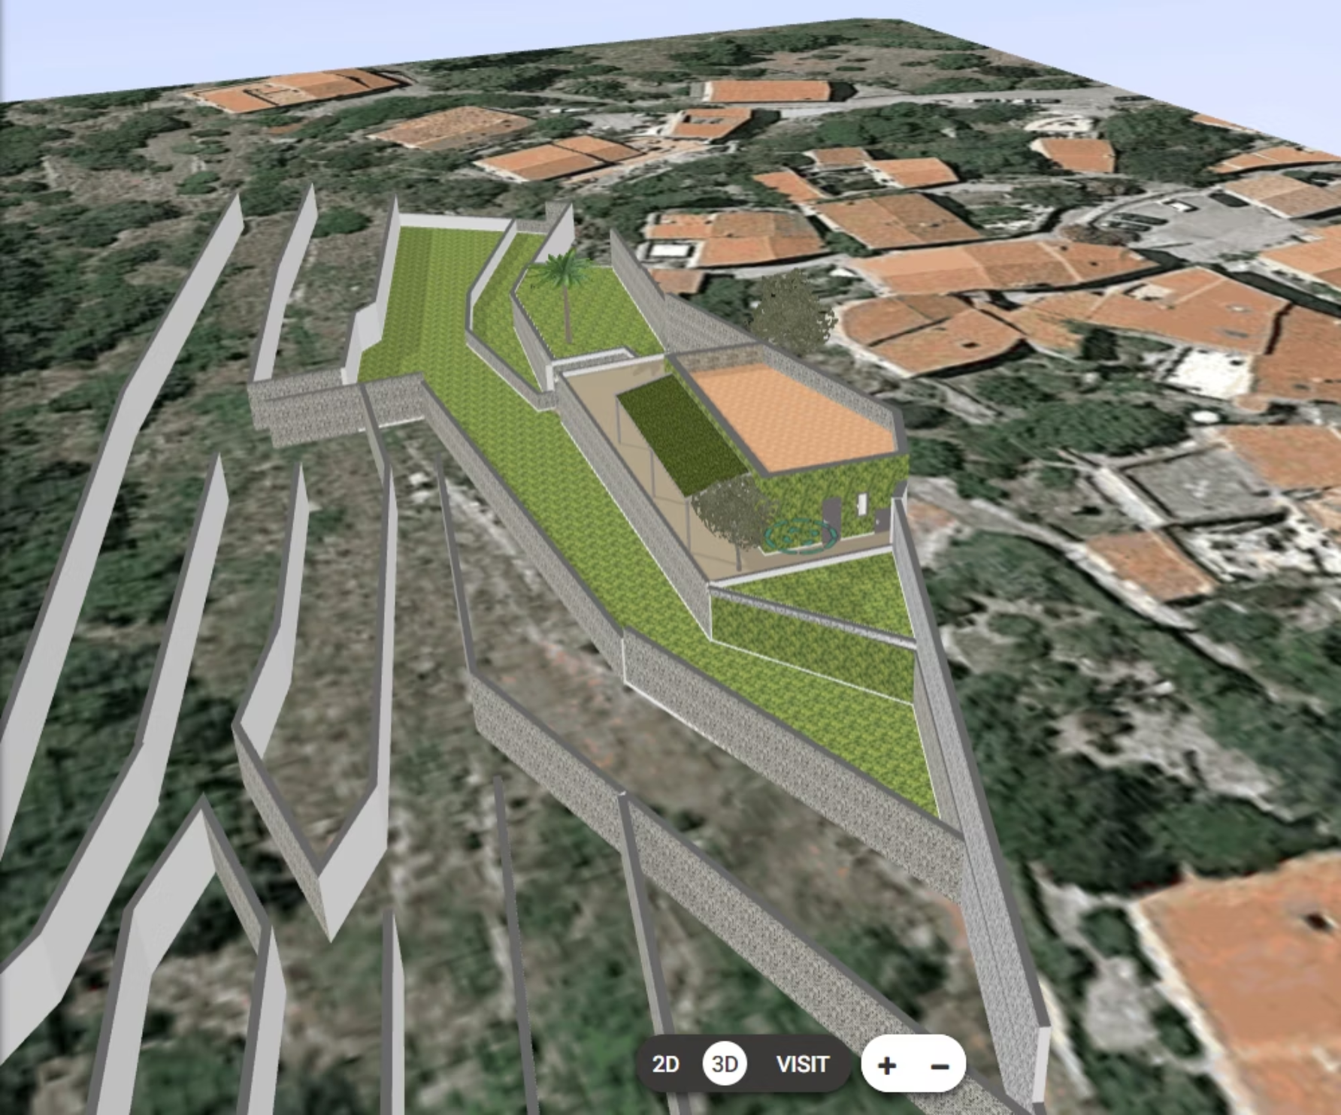
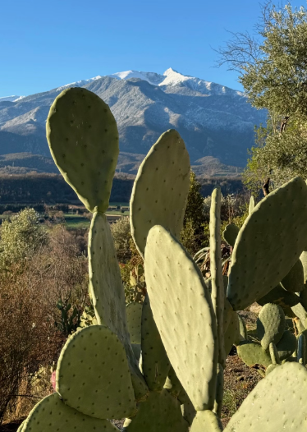
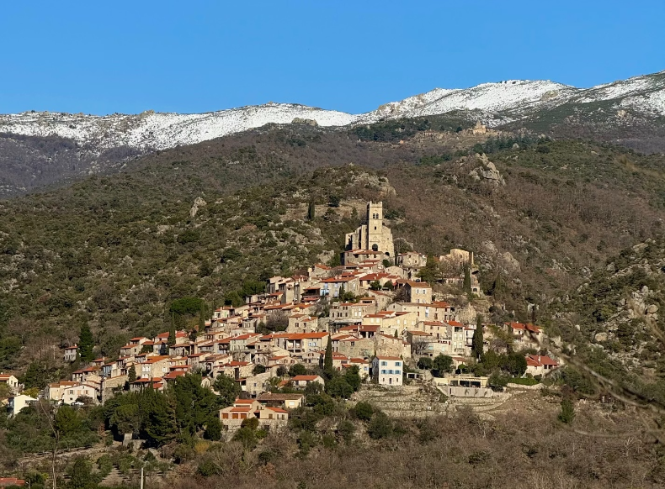
Garden Design and Construction: Terraced Stone Architecture
The Exotic Garden of Eus features a remarkable architectural design that harmoniously integrates with the natural landscape of the region. Key elements include:
Traditional dry stone terraces (terrasses en pierres sèches) that reflect the historical agricultural practices of the region
Carefully planned levels that create distinct microclimates suitable for different plant species
A purpose-built welcome building that serves as both an educational centre and social space
Thoughtfully designed pathways that guide visitors through the botanical collection
The construction process began in earnest in 2022, with significant progress made on the stone terraces and welcome building. The use of traditional dry stone construction techniques not only honours the cultural heritage of the region but also provides excellent drainage for the cacti and succulents, which require well-drained soil to thrive.
The garden's design takes advantage of the natural topography of the site, with south-facing terraces maximising sun exposure for the heat-loving cacti. The stone walls also serve as thermal mass, absorbing heat during the day and releasing it at night, creating a more stable environment for the plants.
Despite delays caused by the COVID-19 pandemic, construction has continued steadily, with the garden scheduled to open to the public in spring 2023.

Slide 5
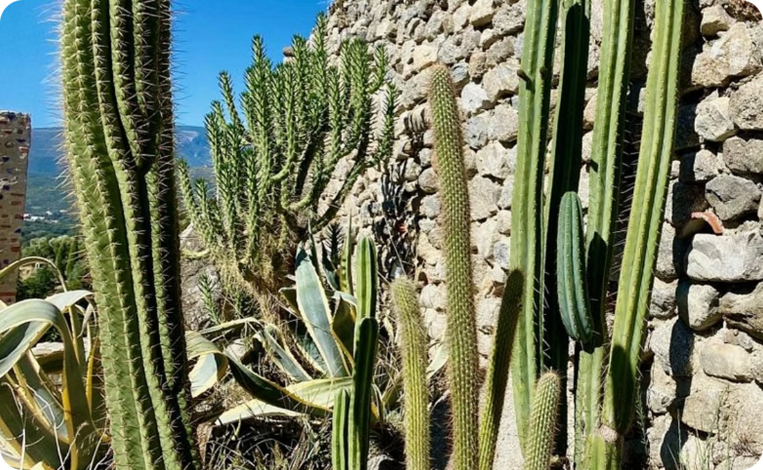

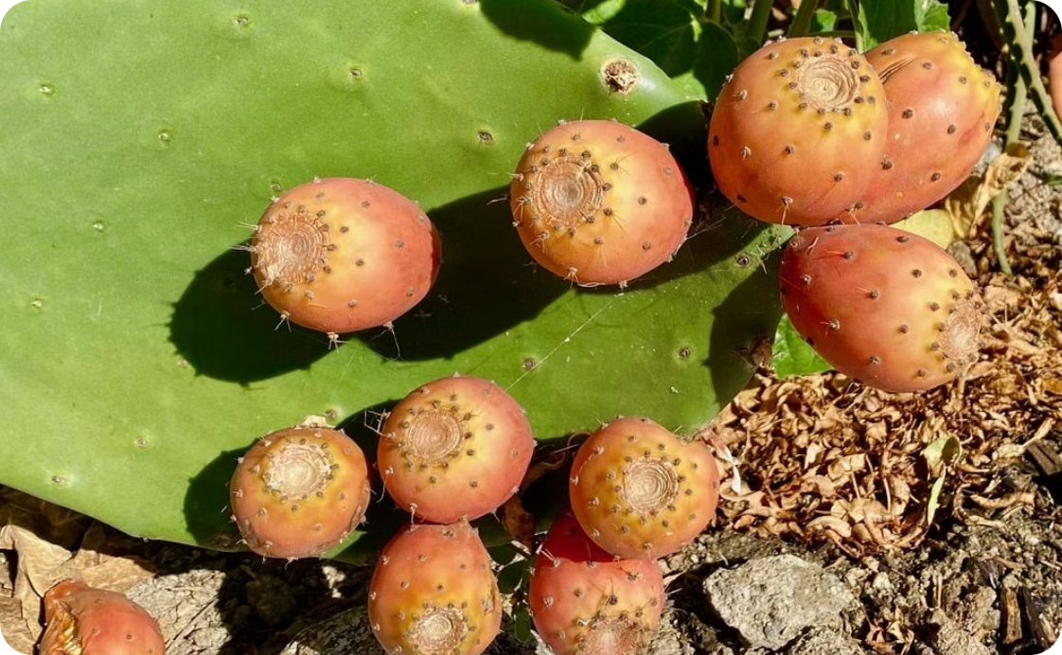
Botanical Collection: Specialising in Cacti and Succulents
Diverse Cactus Collection
Nopal Cultivation
Prickly Pear Production
The garden features an extensive collection of cacti species from around the world, carefully selected for their ability to thrive in the Mediterranean climate of southern France. These architectural plants create dramatic silhouettes against the landscape and demonstrate remarkable adaptations to arid conditions.
A special focus of the garden is the cultivation of Nopal cacti (Opuntia species), which are not only ornamental but also produce edible pads and fruits. The garden serves as a demonstration site for these versatile plants that have potential as sustainable food crops in increasingly arid regions.
The garden cultivates several varieties of prickly pear cacti (Opuntia ficus-indica and related species), which produce the popular "figues de barbarie" or prickly pears. These nutritious fruits are rich in vitamins, minerals, and antioxidants, and form part of the garden's productive aspect.
Beyond cacti, the garden also features a diverse collection of other succulents, including Aloes and Agaves, which complement the cacti with their distinctive forms and textures. Additionally, the garden cultivates rare citrus varieties such as clementines, yuzus, limequats, kumquats, and lemons, as well as pomegranates and passion fruits. This diversity demonstrates how exotic and unusual plants can be successfully grown in the region's climate, potentially inspiring visitors to experiment with similar species in their own gardens.

Slide 6
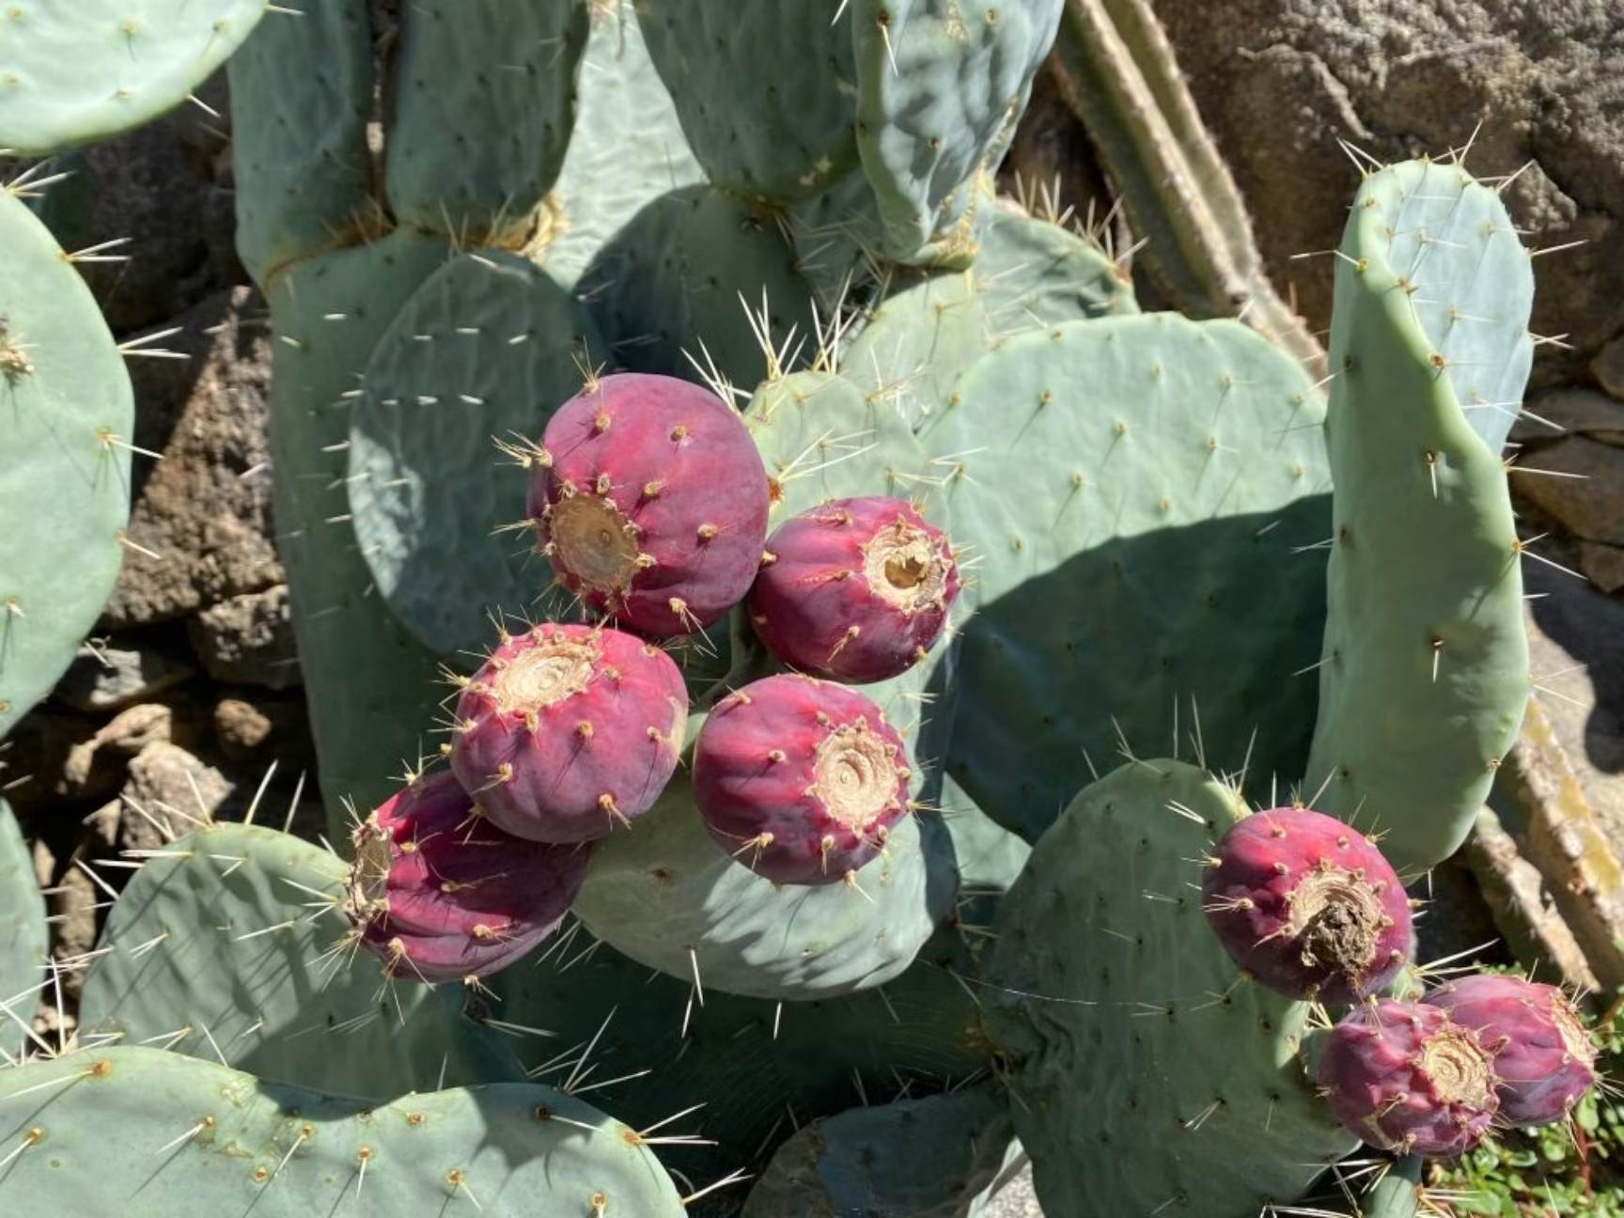
Sustainable Production: Solar Preserves and Exotic Fruits
One of the most innovative aspects of the Exotic Garden of Eus is its focus on productive horticulture alongside ornamental displays. The garden serves as a demonstration site for growing unusual and exotic fruits that are well-adapted to the Mediterranean climate, including:
Nopal cactus pads (nopales) - edible vegetable with numerous culinary applications
Prickly pears (figues de barbarie) - sweet, nutritious fruits from Opuntia species
Columnar cactus fruits - unusual fruits from species like Cereus peruvianus
Rare citrus varieties - including yuzu, limequat, kumquat, and specialty lemons
Pomegranates and passion fruits - Mediterranean and subtropical fruits that thrive in the region
These fruits are not only grown for demonstration purposes but are also harvested and processed into value-added products. A particularly innovative aspect is the production of solar preserves—jams and preserves made using solar cooking techniques, which reduce energy consumption while preserving the fruits' flavours and nutritional properties.
The garden's approach to production emphasises organic and local methods, with all preserves being certified organic and made from fruits grown on-site. This closed-loop system demonstrates sustainable agricultural practices that minimise environmental impact while maximising the value derived from the garden's botanical collection.
By showcasing these unusual fruit crops, the garden also highlights potential diversification opportunities for local agriculture, particularly in the context of climate change, which may necessitate shifts toward more drought-tolerant crop species in the future.

Slide 7

Visitor Experience: Education, Relaxation, and Gastronomy
Botanical and Heritage Trail
Educational Experiences
Gastronomic Exploration
Visitors can explore the garden via a carefully designed botanical and heritage trail that guides them through the collection while providing educational information about the plants and the cultural history of the region. A detailed map helps visitors navigate the various sections of the garden and identify points of interest.
The garden serves as an outdoor classroom, offering opportunities to learn about plant adaptations, sustainable gardening practices, and the potential of drought-resistant species in a changing climate. Informational displays throughout the garden provide insights into the botanical and ecological significance of the collection.
The MOOT Bar and Tapas area offers visitors the chance to taste products made from the garden's plants, including cactus-based dishes and drinks. This culinary dimension adds another sensory layer to the garden experience, allowing visitors to literally taste the fruits of the garden's labour.
The welcome building serves as a hub for visitor activities, housing exhibitions about cacti, succulents, and sustainable gardening practices. Its terrace provides a comfortable space for relaxation and contemplation, with views over the garden and surrounding landscape.
The garden is designed to be a multifunctional space where visitors can engage with nature in various ways—whether actively learning about the plants, quietly reading a book in a peaceful corner, or socialising with friends over tapas made from garden produce.
The MOOT Bar and Tapas area represents an innovative approach to garden catering, focusing specifically on dishes and drinks that incorporate cacti and other plants grown in the garden. This not only provides a unique culinary experience for visitors but also demonstrates the practical applications of these unusual plants in contemporary cuisine.

Slide 8
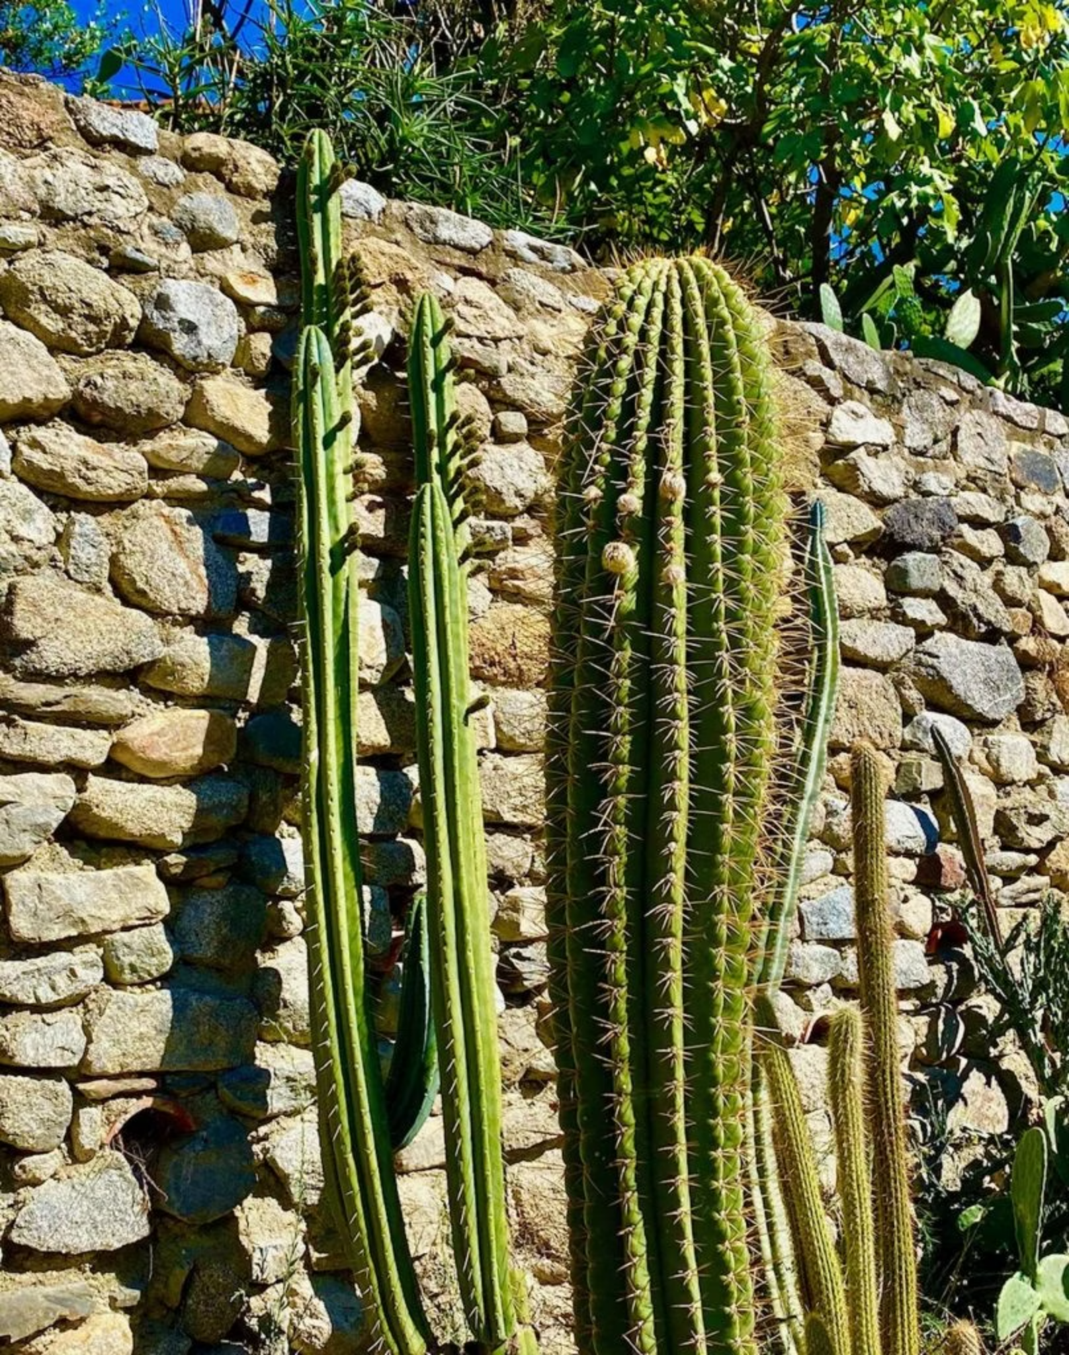
Future Vision: Growth and Community Impact
Despite delays caused by the COVID-19 pandemic, the Exotic Garden of Eus is poised to open its doors to the public in spring 2023. As the garden matures, its impact is expected to grow in several key areas:
Botanical Conservation: The garden will contribute to the preservation of rare and unusual plant species, particularly those adapted to arid conditions.
Educational Outreach: Programmes will be developed to engage schools and community groups, spreading knowledge about sustainable gardening practices.
Tourism Development: As a unique attraction, the garden will draw visitors to the region, supporting the local economy.
Agricultural Innovation: The garden's experiments with exotic fruit production may inspire new agricultural ventures in the region.
Community Engagement: As a shared space, the garden will foster community connections and provide a venue for cultural events.
The garden represents a bold vision for what a public garden can be in the 21st century—not merely a display of plants, but a multifunctional space that combines conservation, education, production, and recreation. By blending botanical expertise with artistic expression and sustainable practices, the Exotic Garden of Eus offers a model for future garden development that responds to contemporary environmental and social challenges.
As climate change continues to affect the Mediterranean region, the garden's focus on drought-resistant species and sustainable water management practices will become increasingly relevant, potentially serving as a demonstration site for adaptation strategies in horticulture and agriculture.

